Slide 1
4x4 – First Eight Edges
COLL 134
Week 10

Slide 2
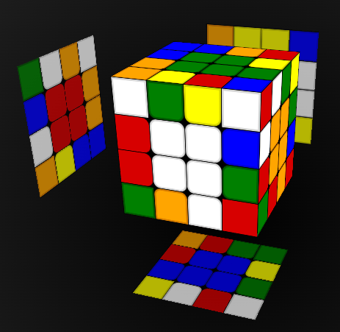
4x4 Edges
U layer
B face
B face
F face
(pairing zone)
D layer

Slide 3
Pairing Procedure
Each edge = 2 “half-edges”
For each edge:
Position half-edges in pairing zone
Perform pairing moves
Remove paired edge from pairing zone
Solve 4 edges into D layer
Solve 4 edges into U layer
Solve 2 edges into B face using replacement
Solve last 2 edges (F face) using algorithm
Steps 1 and 2 = First 8 Edges (F8E)
Steps 3 and 4 = Last 4 Edges (L4E)

Slide 4
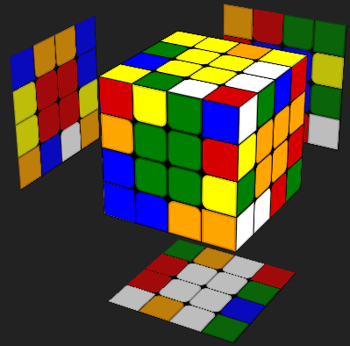
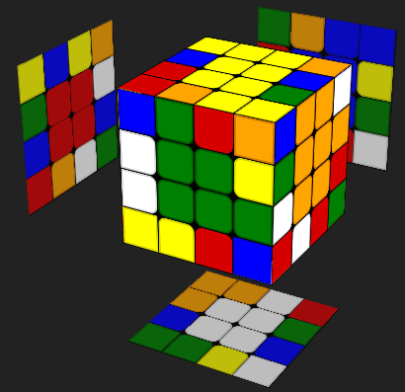
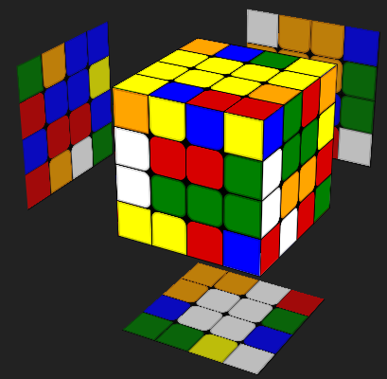
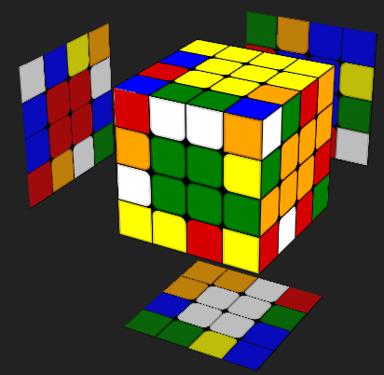
Pairing Procedure Visualization
???
???
???
Position half-edges in pairing zone
Perform pairing moves
Remove paired edge from pairing zone

Slide 5
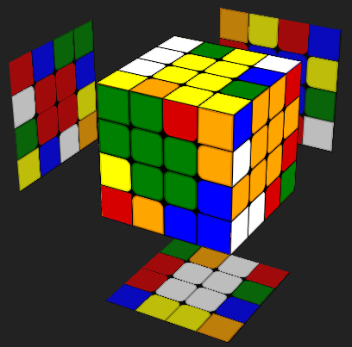
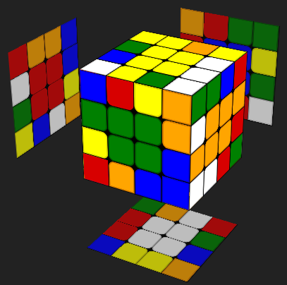
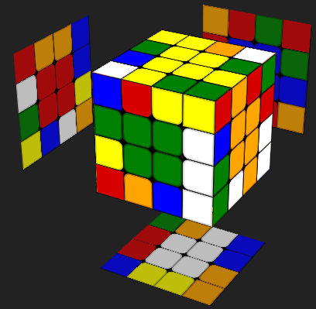
Positioning Half-Edges

Slide 6
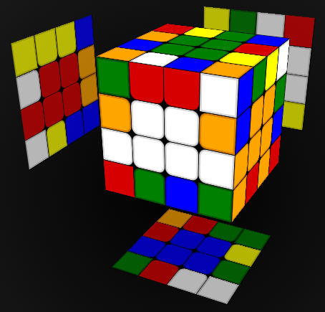
Case #1 – diagonal orientation
Pairing white-orange edge
Slice to pair

Slide 7
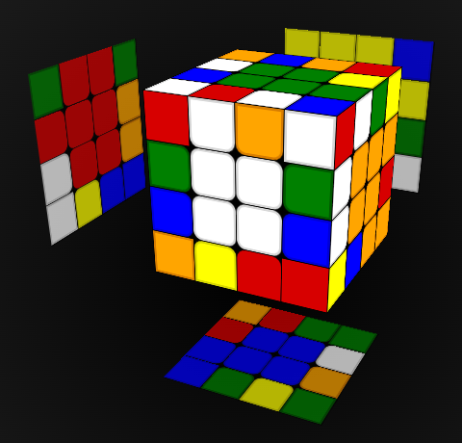
Case #2 – adjacent orientation
Pairing white-blue edge
First, flip one half-edge
Then, slice to pair

Slide 8
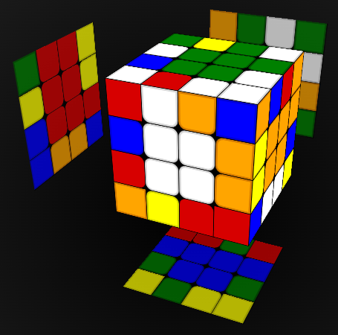
Case #3 – already paired
“Pairing” yellow-orange edge
Move to a better position

Slide 9
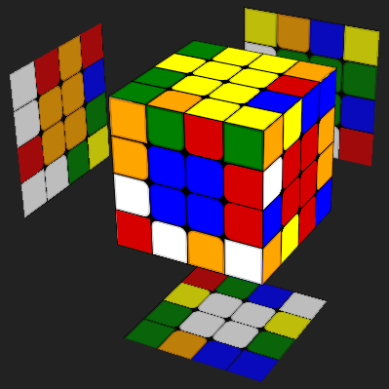
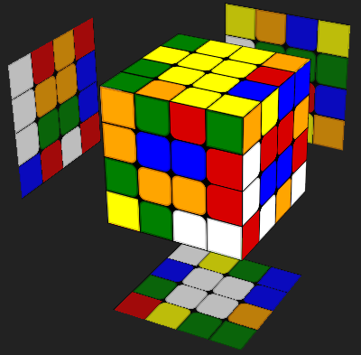
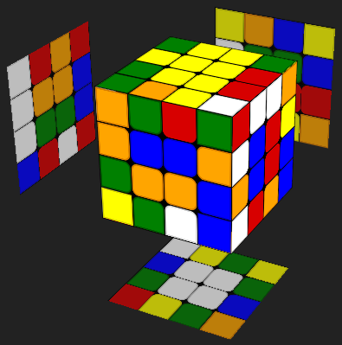
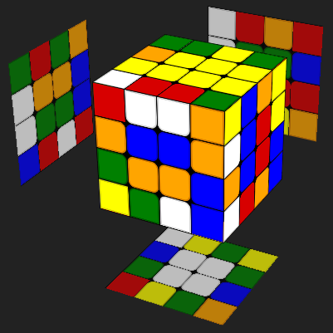
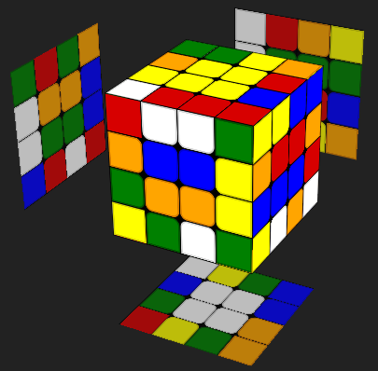
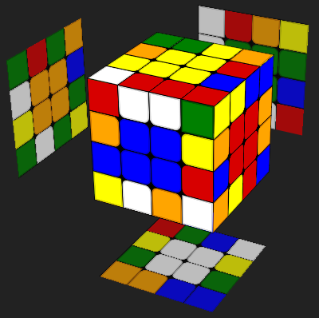
Storing Paired Edges

Slide 10
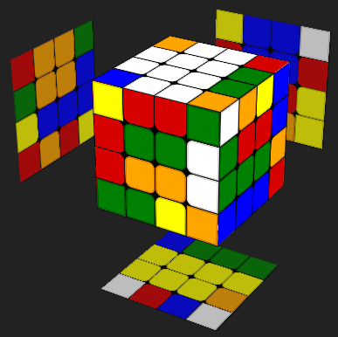
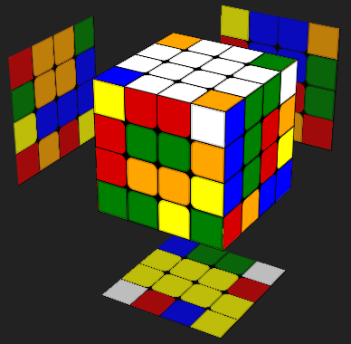
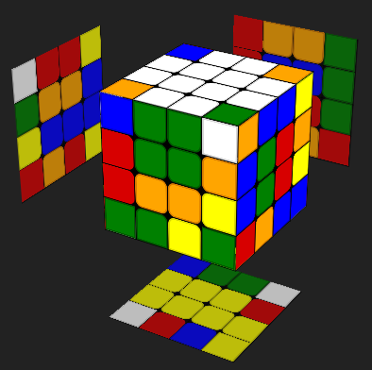
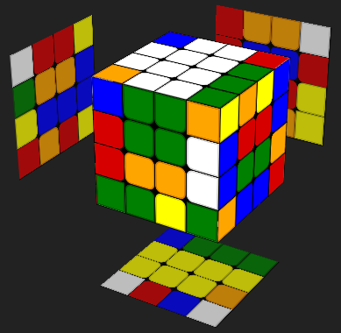
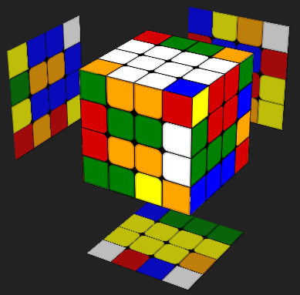
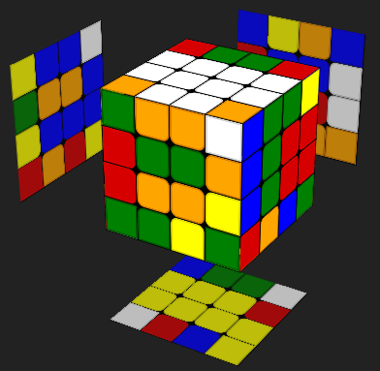
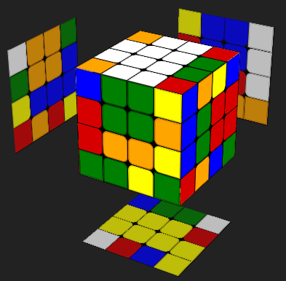
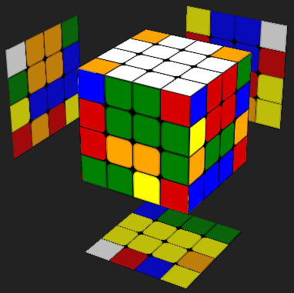
Displacement for Edges
No unpaired edge left to bring into pairing zone; no progress made
White-green edge is paired; target to unpaired edge in U layer

Slide 11
Freeslice Method
Advanced type of edge pairing
Difference: do not restore sliced centers until after completing F8E
(+) – much faster edge pairing
no fixing centers after every edge → eliminate 2 slice moves per edge
(-) – high risk of making mistakes
lose track of cube orientation → scramble centers → start over

